Slide 1

Crime Data Report – City of Los Angeles
Lakshmi Deepti Pamula, Mani Katuri

Slide 2
Background
In areas where access to police security and education is lacking, crimes and public assaults are among the most common to occur. Various types of offenses include burglary, theft, assault e.t.c.
Early identification of high-risk locations, identify crime patterns over time, ability to visualize crime hot spots can assist in assessing the public safety initiatives, educate residents and stake holders. This will lower the crime rate, unanticipated attacks on commoners, improved rostering for the police departments.

Slide 3
Objective
The prime objective of this study is to come up with a clustering model that can categorize locations, gender of victims and their ages, crime times. This model can work as a decision support system for Los Angeles police department to make prudent decisions regarding staff rostering, education to locals, conducting mock drills to bring awareness in the residents in reducing the victims.

Slide 4
Methods
The dataset is a public data made available by the Los Angeles Police department. The crimes reports starting from Feb, 2020 to the latest May 2025 was made publicly accessible with at: Crime Data from 2020 to Present – Catalog
Data Cleaning and Preparation: The data is examined using python code and identified 28 features comprising of crime report dates, Victim gender, ages, locations with Longitude and latitudes, type of crime and weapon use, severity of the crime e.t.c. There are several missing data values in the original dataset with highest missing values related to weapon details and crime codes. The sub codes for crime details are ignored for data analysis since the main code is consistently available.

Slide 5
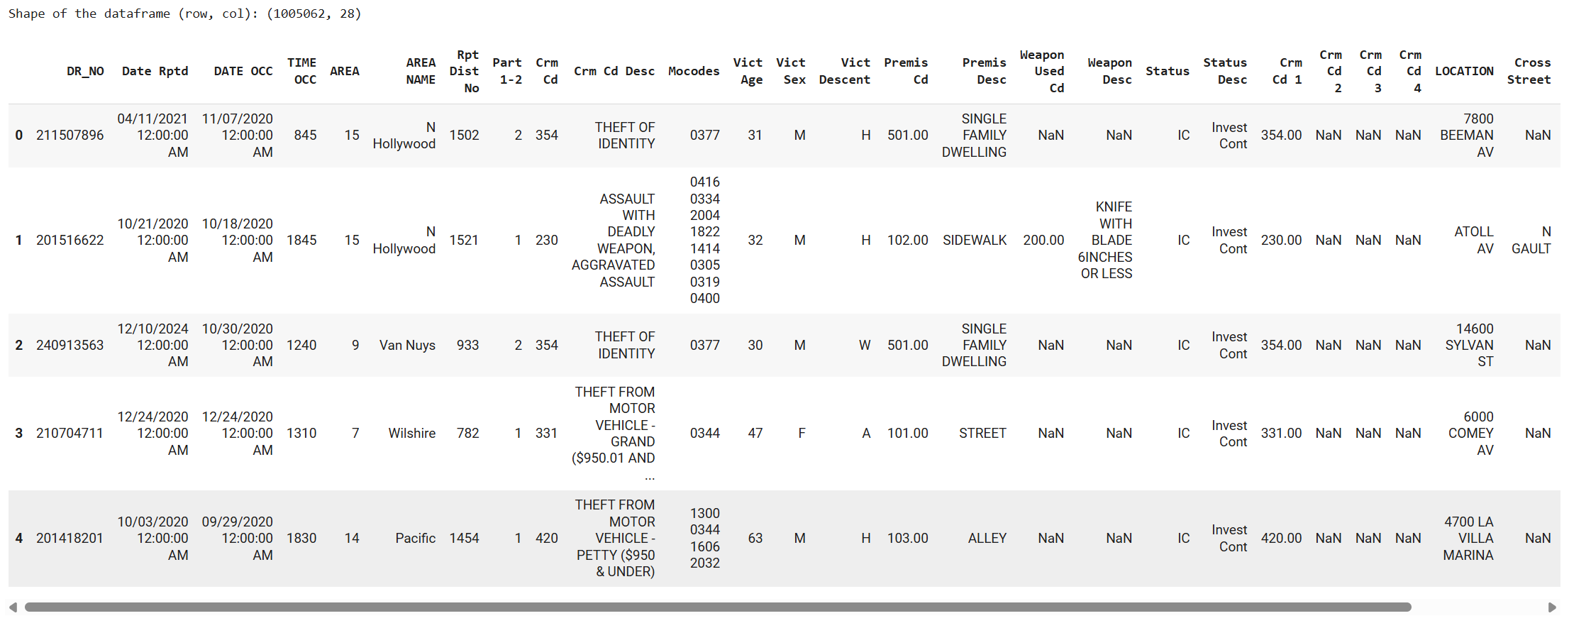
Data Statistics
Few data rows from the original dataset:

Slide 6
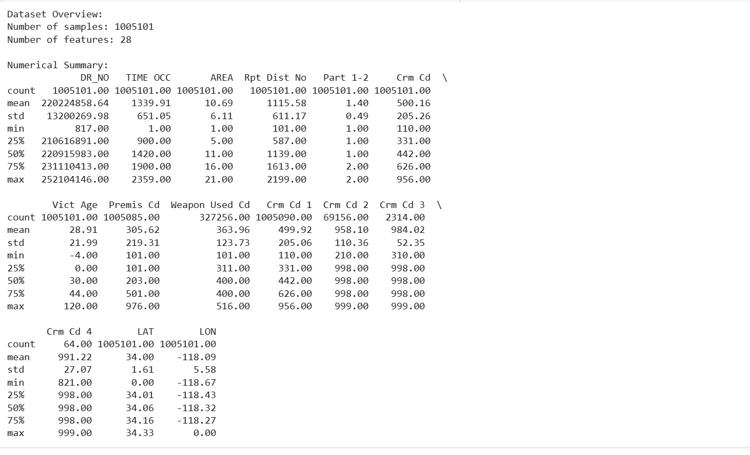
Data Statistics
Numerical summary for each column from the original dataset:

Slide 7
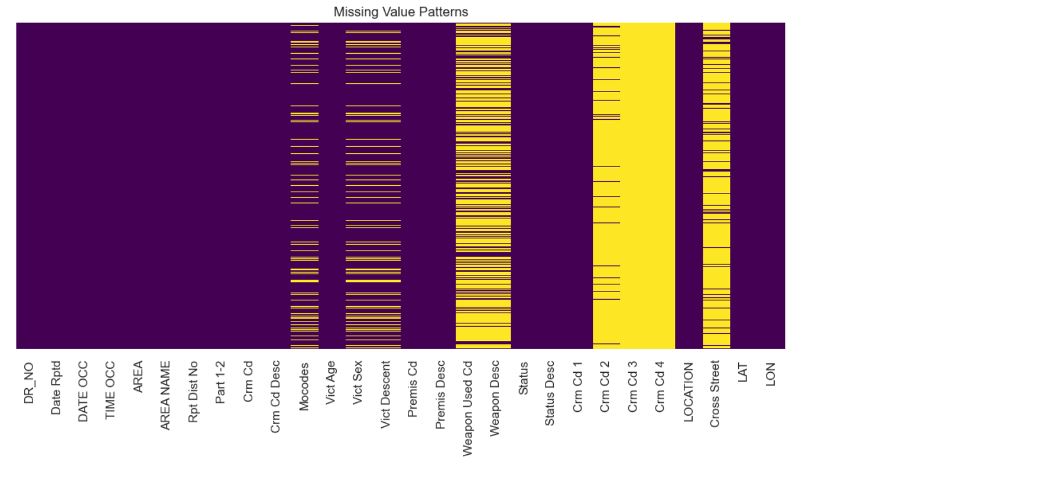
Data Statistics
Pattern for missing values from the original dataset:

Slide 8
Methods
Data Processing: Since the objective of this project is to find the victims, we considered categorizing them into Male / Female genders. The dataset is filtered for records from these two genders for only last 3 years data.
Invalid Latitude and Longitude rows were deleted as outliers distort the cluster representation.
Redudnant features were dropped so as to reduce the noise.
Binning is applied to Victim’s age, so it gives better business perspective.
Hot encoding is applied to mark rows if a specific row contains one of Male / Female gender and Victim Age group to aid in future computations.

Slide 9
Model Algorithms
After the Data pre-processing and hot encoding, dropping null values and filtering out for Male / Female gender, the dataset contains more than 250K records.
To successfully work with this kind of high datasets, we used the following clustering models:
MiniBatchKMeans
Gaussian Mixture
Birch

Slide 10
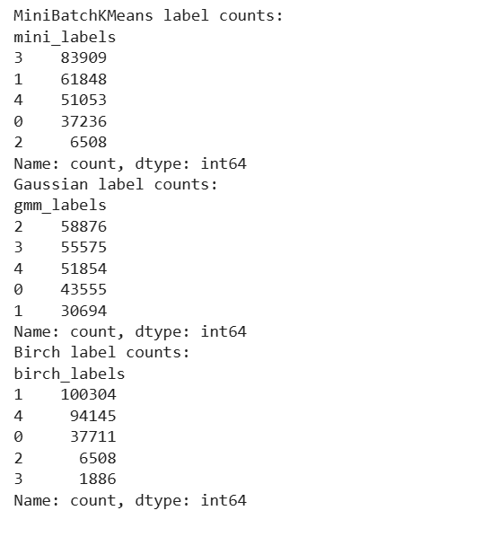
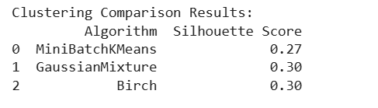
Results Comparison
Cluster label counts comparison for the 3 models:
Silhouette scores comparison for the 3 models:

Slide 11
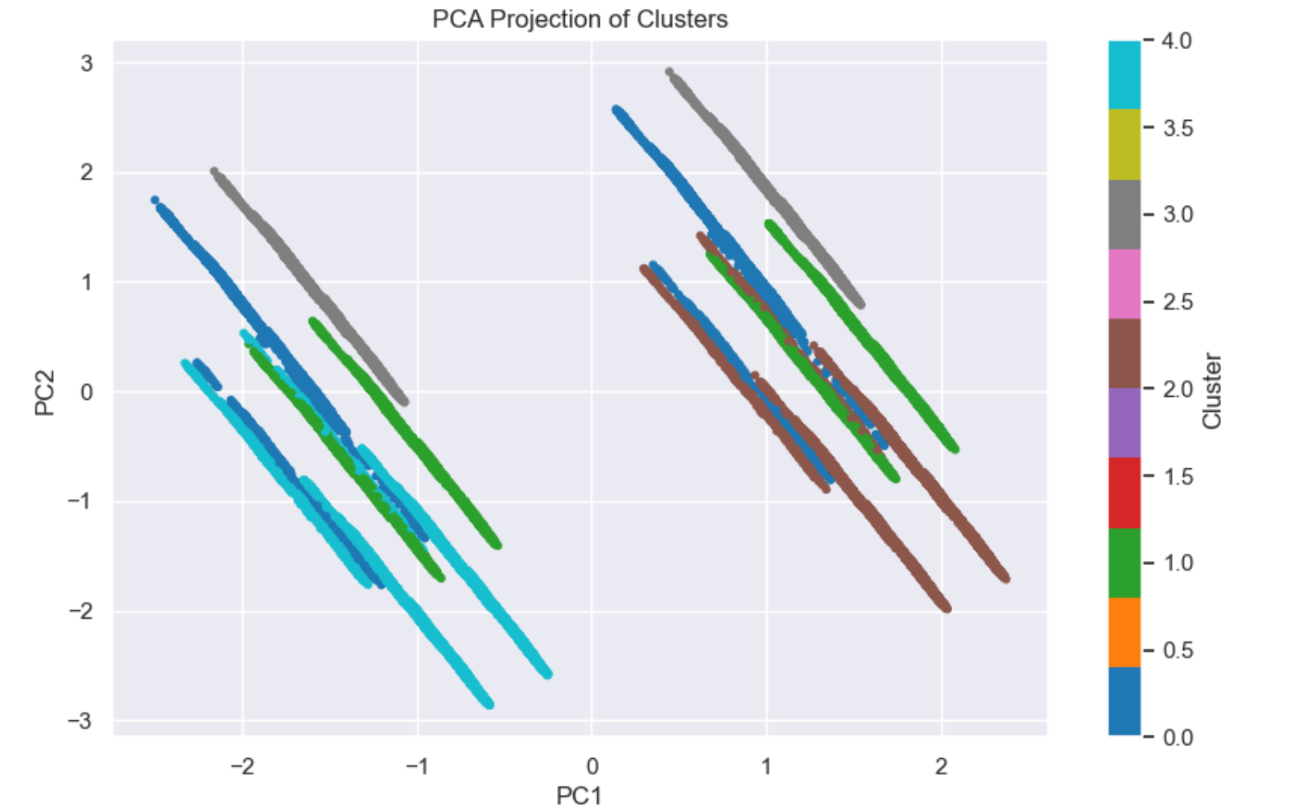
Visualization
The visualization plot shows clearly defined clusters with some over lapping.
We see a linear patterns show some strong correlation between features selected.

Slide 12
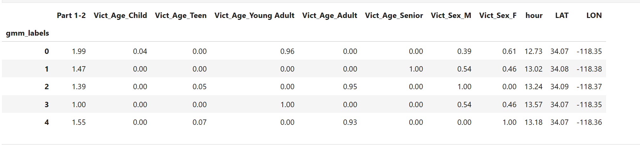
Conclusion
Cluster 0:Primarily female young adult victims, non-serious crimes (e.g., petty theft), occurring around 1 PM near Lat 34.07, Lon -118.35. Indicates vulnerability during lunch hours.
Cluster 1:Elderly victims, mixed gender, both serious and non-serious crimes. Highlights the need for senior safety programs.
Cluster 2: All male victims, mostly adults, few teens, mostly non-serious crimes. Can be deprioritized to free up police resources for critical zones.
Cluster 3:Serious crimes involving young adults, balanced gender ratio, also around 1 PM near Lat 34.07, Lon -118.35. Suggests need for police surveillance for possible street violence.
Cluster 4:Female victims, mainly young adults and some teens, mixed crime severity. Could indicate domestic or gender-based violence outreach and awareness programs recommended.

Slide 13
Deployment
Based on the findings of the clusters, daily and weekly patrolling can be efficiently used in crime prone areas.
Launching Elderly outreach Women safety programs would make commuters aware and take precautions as needed.
Not just relying on outdated data but crime data should be updated on daily or weekly basis to get latest trends and be able to allocate resources accordingly.

Slide 14
Thank you !!

